Slide 1

Title IX Informal Resolution

Slide 2
Agenda
Know Our Why
Rendering unto Caesar: Complying With The Legal Requirements
Green, Yellow, or Red Light: Is IR Right For This Situation?
Communications with Parties & Ensuring Voluntary Participation
Types of Informal Resolution
Step-By-Step Mediation

Slide 3
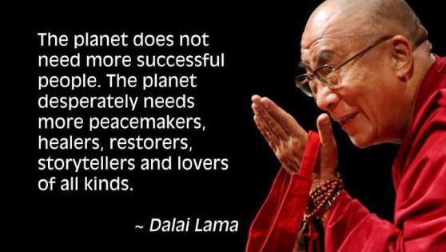

Slide 4
First Principles: Overarching Title IX Duty
Prevent/Remedy Sex Discrimination!
Supportive measures
Equitable treatment
Respond to known acts of sexual harassment in a manner that is not “clearly unreasonable”
Generic Hypo: Your president has asked you to explain to him why the university’s response to a report of sex harassment was not clearly unreasonable.
What facts would you want to be able to cite?

Slide 5
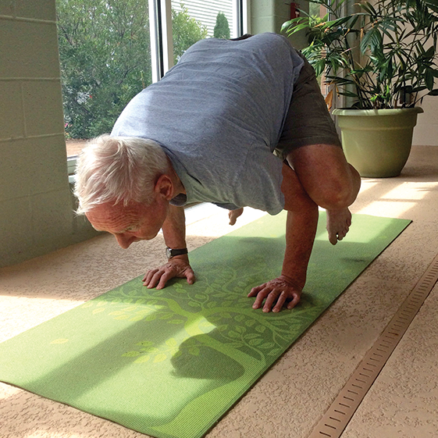
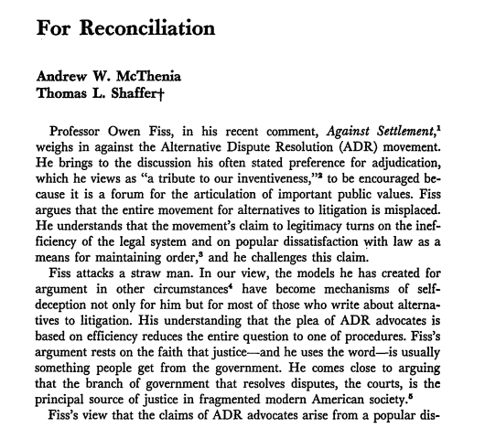
What Are The Shortcomings of Investigation/Adjudication?

Slide 6
The Law (Now): Informal Resolution & Regulations
“[A]t any time prior to reaching a determination regarding responsibility the recipient may facilitate an informal resolution process, such as mediation, that does not involve a full investigation and adjudication, provided that the recipient . . .”
(i) Provides to the parties a written notice disclosing: the allegations, the requirements of the informal resolution process including the circumstances under which it precludes the parties from resuming a formal complaint arising from the same allegations,
provided, however, that at any time prior to agreeing to a resolution, any party has the right to withdraw from the informal resolution process and resume the grievance process with respect to the formal complaint, and
any consequences resulting from participating in the informal resolution process, including the records that will be maintained or could be shared (*7 years);
(ii) Obtains the parties’ voluntary, written consent to the informal resolution process; and
(iii) Does not offer or facilitate an informal resolution process to resolve allegations that an employee sexually harassed a student.

Slide 7

Break That Down
An optional institutional alternative (should, when, how, & by whom)
Guidance paperwork (how does process work & consequences of participating in the process)
Voluntary for both sides (how to assess & demonstrate)

Slide 8
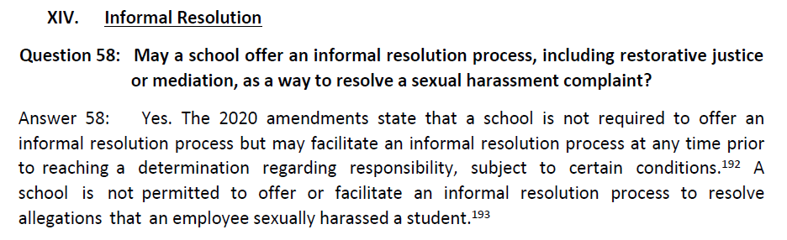
Just FYI: Informal Resolution in Biden Q&A
Notes:
Conditions begin those we described on the prior slide – under 106.45(b)(9).

Slide 9
In The Courts
Very few reported cases analyzing informal resolution practices
Why?
Federal courts have been reluctant to allow deliberate indifference claims based on an institution’s use of an informal resolution process in general
Key issues: voluntariness, timeliness, and remedies/enforcement
Communicate with parties about status (where are we)
If the institution follows policies and procedures, courts appear to be reluctant to second-guess the decision or outcome.

Slide 10
Hypothetical 1
Complainant and Respondent are good friends and attended a party together where they both drank a lot of alcohol
They left the party together and went back to Respondent’s residence hall
While in Respondent’s room, they had what drunken Respondent believed was consensual intercourse
The next day, Complainant texted Respondent that Complainant was upset and hurt because Respondent took advantage of her when she was too intoxicated to consent
Complainant decided to report Respondent to the Title IX Coordinator

Slide 11
Threshold Question: Should Informal Resolution Even Be An Option?
The Easy “No”: allegations that an employee sexually harassed a student
The Complicated: Are there situations where informal resolution would be not appropriate (or “clearly unreasonable”)?
One potential guidepost: if allegations are true, would it be appropriate for accused to remain on campus (on-going threat to campus community → gravity of the alleged offense, repeat offender, risk of repeating, weapons, minor victim, etc.)

Slide 12
Back to Hypothetical
What are the reasons why IR should be an option?
Should not be an option?
Complainant and Respondent are good friends and attended a party together where they both drank a lot of alcohol
They left the party together and went back to Respondent’s residence hall
While in Respondent’s room, they had what drunken Respondent believed was consensual intercourse
The next day, Complainant texted Respondent that Complainant was upset and hurt because Respondent took advantage of her when she was too intoxicated to consent
Complainant decided to report Respondent to the Title IX Coordinator

Slide 13
Three Suggested Best Practices
Clear policy language is important -- Make sure the policy reflects (a) who needs to consent to an informal resolution and (b) what factors university officials will consider
Show your work -- document your analysis (sorry)
Monitor for consistent application and implicit bias (i.e., similar fact patterns should be handled consistently)
The benefit of blanket rules

Slide 14
A Couple of Complicated Scenarios: What To Do?
Significant allegations but complainant does not want to go through investigation/adjudication process
Significant allegations but you know there are proof issues & have a hunch end result will be unfavorable

Slide 15
You Say Yes! Now to Complainant
Discuss options with Complainant
Explain the IR process in writing
Form document that satisfies regulatory requirements → Have a non-lawyer human being read this for clarity
If Complainant says “no,” that’s a wrap
What do you say about IR?
What are pros & cons to mention?
What should you avoid?
Timing?
What are some of the questions you may get from the Complainant?

Slide 16
Basics: We Love Supportive Measures!
So, so important!
In general: non-disciplinary, non-punitive support and accommodations designed to preserve access to education programs and activities & without unreasonably burdening the other party
Examples?
To issue NCO or not?

Slide 17
Complainant Say Yes! Now to Respondent
Discuss options with Respondent
Explain the IR process in writing
Form document that satisfies regulatory requirements → Have a non-lawyer human being read this for clarity
If Respondent says “no,” that’s a wrap
What do you say about IR?
What are pros & cons to mention?
What should you avoid?
Timing?
What are some of the questions you may get from the Respondent?
*** can this be used against me in a subsequent proceeding? Sent to subsequent schools? Part of education record?

Slide 18
How Do We Ensure Voluntary Participation?
Clear communications (can’t stress this enough)
Be timely, but don’t rush
Require parties to sign a clear Participation Agreement
Periodic check-ins and monitoring (Who? How?)
Reiterate where appropriate that either party can stop the process
What would be a red flag about a party’s voluntary participation?
Rule → when in reasonable doubt, put concern on table/stop the process
Show your work (again – sorry)
What if…once you’re done, a party objects that they didn’t, in fact, voluntarily participate?

Slide 19
Hypothetical 2
Jesse, sophomore walk-on, accuses the captain and All-Conference power forward, Toni, of sexual harassment after Toni kisses Jesse in a hotel room during an in-season basketball away game.
At the intake meeting, in August (outside of basketball season), Jesse explains that Jesse will never informally resolve this issue. Jesse files a Formal Complaint, and proper notices have been sent to the parties and support measures are in place. The day after the basketball season starts, while the investigation is underway, Jesse decides that Jesse wants to proceed informally. Toni is “totally on board.”
You are asked to assess the propriety of utilizing informal resolution:
What issues from the facts above do you want to figure out/dig into more?
How?
What questions will you raise with Jesse?
What questions will you raise with Toni?
What are the red flags?

Slide 20
Types of Informal Resolution
Administrative adjudication
Facilitated conversations
Restorative justice
Mediation

Slide 21


Slide 22
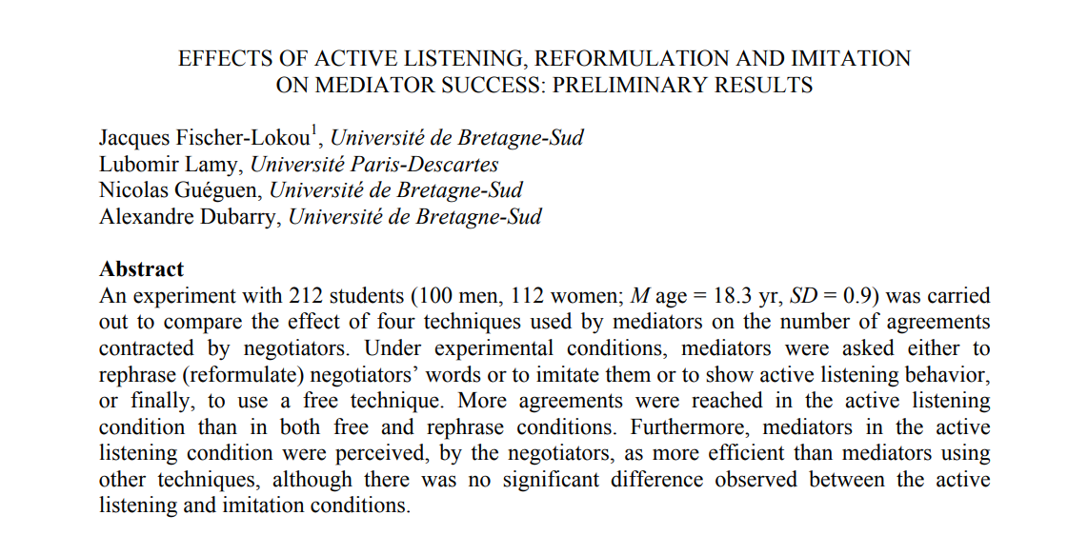
What Makes A Good Mediator?
Reasonable participants ☺
Ability to establish rapport
Listening for Understanding/Establishing trust (what can I share?)
Soliciting what parties want & setting expectations
Creativity

Slide 23
Four Items For Preparation Of Mediator
Reasonable summary of report and status
Background information on parties and advisors
Information for assessment of potential conflicts
Summary of concerns raised (if any) in screening process

Slide 24
My Personal Preference for Process Steps
Send an introductory communication where I discuss process and begin scheduling meetings
Meet with complainant (listen primarily & get a sense of remedies sought)
Meet with respondent (listen primarily & get a sense of willingness to address harm)
Assess and plot next steps

Slide 25
Other Considerations
Some mediations begin with both sides in the room together sharing account – I’m generally not a fan
Is in person preferable for party meetings?
Can advisors be helpful or harmful? How to engage?

Slide 26

People quickly reach “macro” conclusions (pleasant, kind, hostile, creepy, competent) based on “micro” traits (smiling, eye contact, open- handed gestures, fidgeting, stiff posture, facing another direction)
What is macro impression we are trying to communicate and what are nonverbal micro cues that can get us there?

Slide 27
Some General Question Possibilities
“I’ve read the materials in this matter and am familiar with the report, is there anything else you think is important to share with me?”
“Can you walk me through what you would like to achieve through this process?”
“Are there things you are willing to do remedy the harm Complainant has expressed?”

Slide 28
Hypothetical 3
In initial meeting with Complainant, Complainant says, “this process will be a failure to me if Respondent is not expelled.”
Q 1: How do you respond to that?
Q 2: At what point do you shut things down?

Slide 29
Hypothetical 4
Complainant has accused Respondent of hostile environment sexual harassment.
Respondent admits to the alleged conduct but asserts it “wasn’t that bad” and “won’t do anything to fix this because Complainant is being ridiculous.”
Complainant alleges being so affected by the conduct that Complainant stopped attending their shared science class.
Complainant requests an on-going no contact order, educational sessions for Respondent, and that Respondent be restricted from the current shared science class and any other upper-level science courses Complainant enrolls in in the future.
What are some follow-up questions you may have for Complainant?
Respondent?
Are you willing to persuade Respondent to move off position?
If so, how?

Slide 30
How Long Should Process Take?
From regulations: “reasonably prompt” with extensions for “good cause” with written notice to parties
Practical 1: comply with institutional policy
Practical 2: I worry when I’m past 21 days from receiving file
Is there a reasonable basis for resolution?
Is it worth setting a firm deadline for a response?
Ensure parties and IX Coordinator are apprised of where things stand

Slide 31
Return to Hypothetical 1
Complainant and Respondent are good friends and attended a party together where they both drank a lot of alcohol
They left the party together and went back to Respondent’s residence hall
While in Respondent’s room, they had what drunken Respondent believed was consensual intercourse
The next day, Complainant texted Respondent that Complainant was mad because Respondent took advantage of her when she was too intoxicated to consent
Complainant decided to report Respondent to the Title IX Coordinator
Q1: What are some possible terms for resolution?
Q2: What is role of Title IX Coordinator prior to finalizing agreement?

Slide 32
Some Outcome Examples
Administrative accommodations such as adjusting class schedules, changing sections, etc.
Apologies
Voluntary educational, mentoring, or coaching sessions
Relocation or removal from a residence hall or other on-campus housing
Verbal cautions/warnings
Training
Collaborative agreements on behavioral or institutional changes
No on-going contact
Voluntary withdrawal from university ***

Slide 33
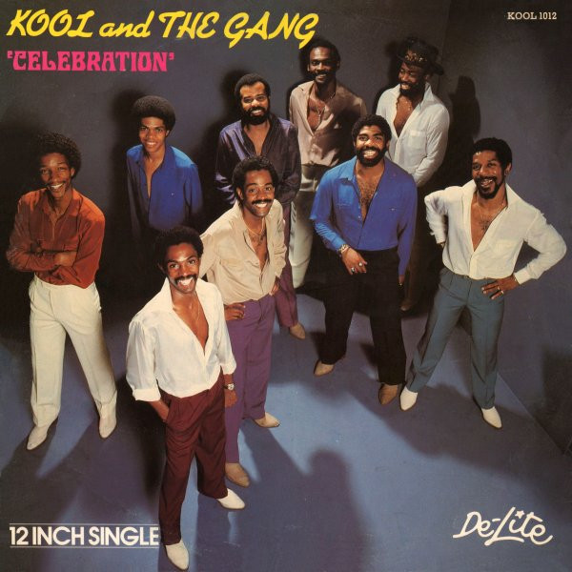
Agreement
Explanation/background regarding formal complaint, allegations, and implicated polic(ies)
Notice that this is lieu of a formal finding of a violation or no violation of policy (emphasizing voluntariness)
Description of what has been agreed upon
What will occur moving forward including violations of informal resolution agreement
Future allegations of misconduct against respondent arising out of same facts as underlying complaint (reopening result?)

Slide 34
Agreement
Future discipline of respondent
Confidentiality
Explicit notice that each party is agreeable to these outcomes
Notice regarding institution’s commitment to campus free from discrimination and harassment and anti-retaliation language
Signatures and dates for the parties, as well as Title IX Coordinator

Slide 35
Example Confidentiality Language in Agreements
“I agree that to the extent permitted by law, I will not use information obtained and utilized during informal resolution in any other institutional process (including investigative resolution under the Policy if informal resolution does not result in an agreement) or legal proceeding, though information documented and/or shared during informal resolution could be subpoenaed by law enforcement if a criminal investigation or civil suit is initiated.”

Slide 36
Post-Conference: Monitoring
This is mission critical!
Clarity on who is responsible
Hypo: Respondent becomes non-responsive and does not participate in agreed-to educational activities.
How do we enforce?

Slide 37


Slide 38
No Celebration!
Either party may withdraw their consent to participate in informal resolution at any time before a resolution has been finalized.
Advise Title IX Coordinator
Document process ended

Slide 39
Guideposts (One More Time)
Respond to known acts of sexual harassment in a manner that is not “clearly unreasonable”
Complainant: Continue in educational program
Respondent: Continue in educational program so long as there is no harm to campus community
The perspective is peacemaking, supportive, and educational – it’s not confrontational, punishment-oriented, or overly legalistic
Keep the parties posted
Be honest with the parties, but stress they control outcome (this is voluntary!)
Be timely

Slide 40


